Slide 1
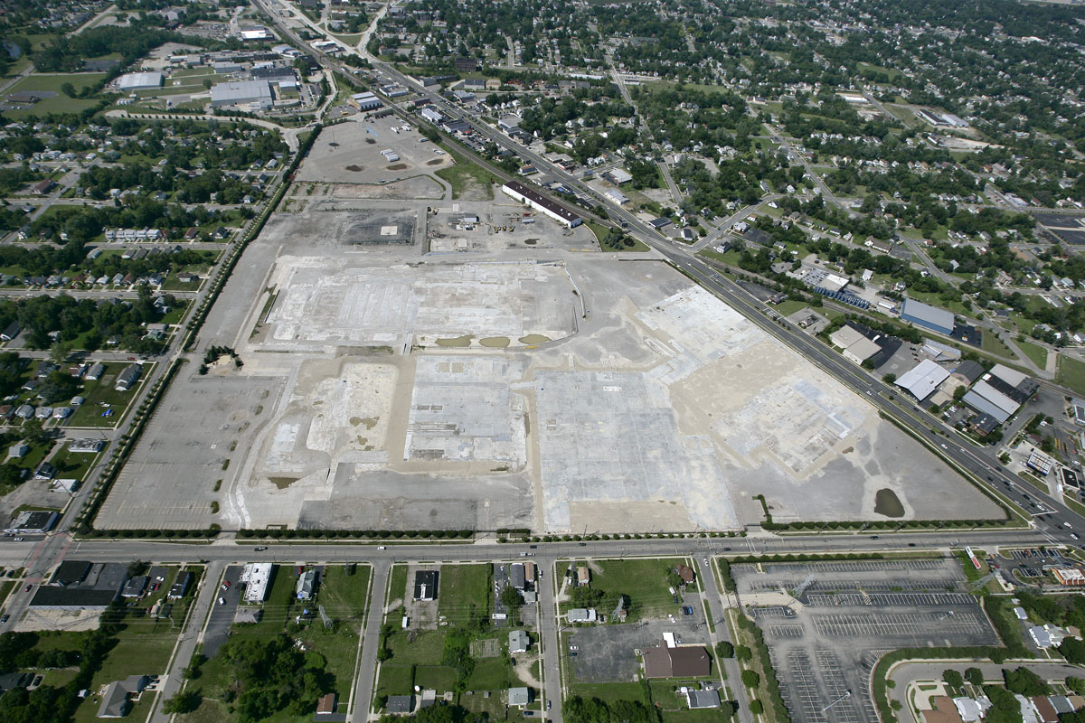
Pontiac Validation
Location: Pontiac, MI
Approximate Size: 82 Acres
Status: Demolition completed in 2009

