Slide 1
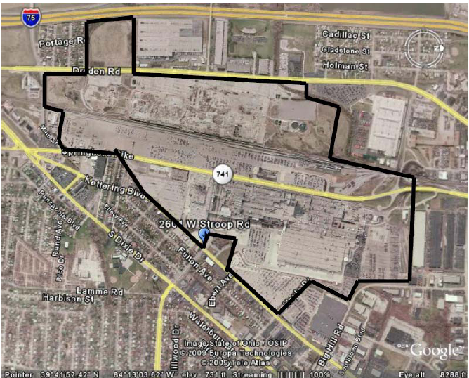
Sell for Re-Use: Moraine Lagoon
Lagoons
Assembly
Plant

