Slide 1
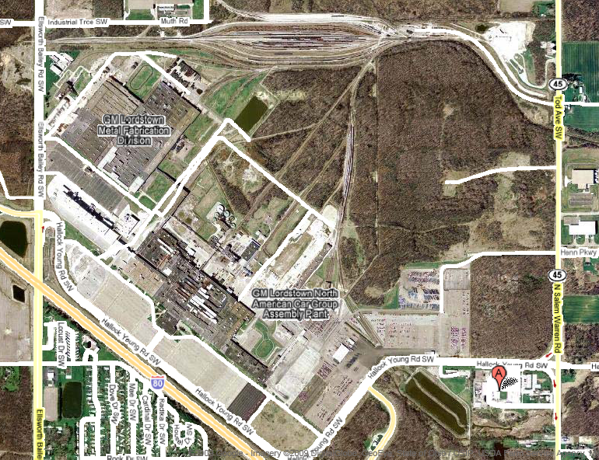
Donate: Lordstown Excess Land

