Slide 1
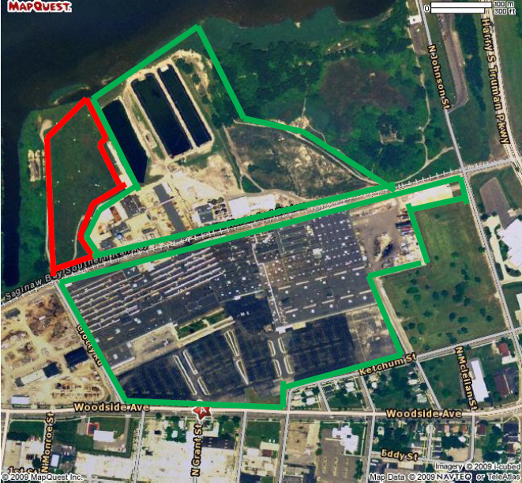
Bay City REALM Parcel

