Slide 1
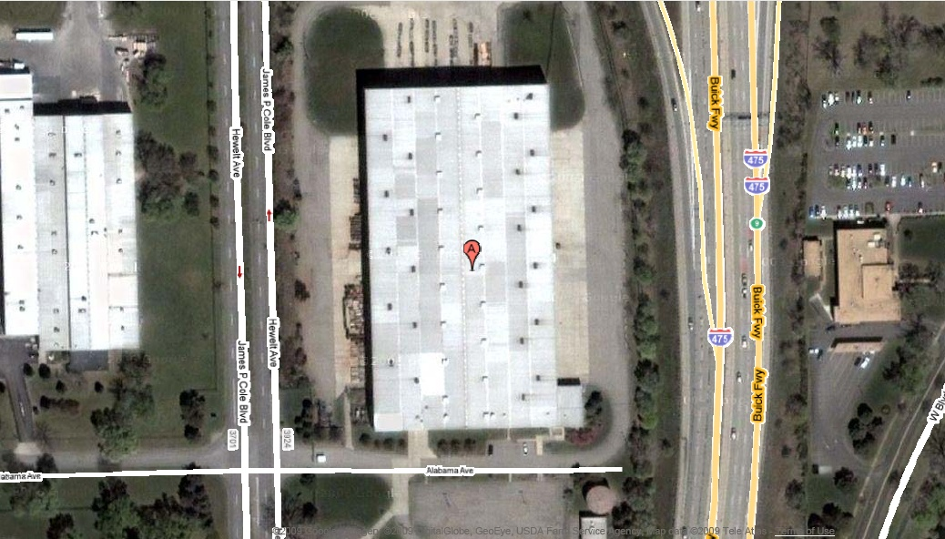
Flint Flowthrough WH

