Slide 1
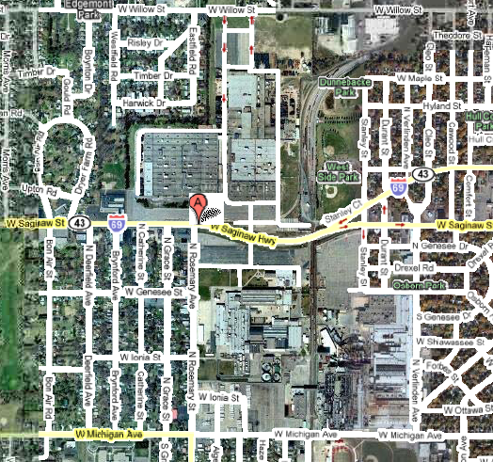
Lansing Plants 2, 3 & 6
Plant 3
Plant 2
Plant 6

