Slide 1
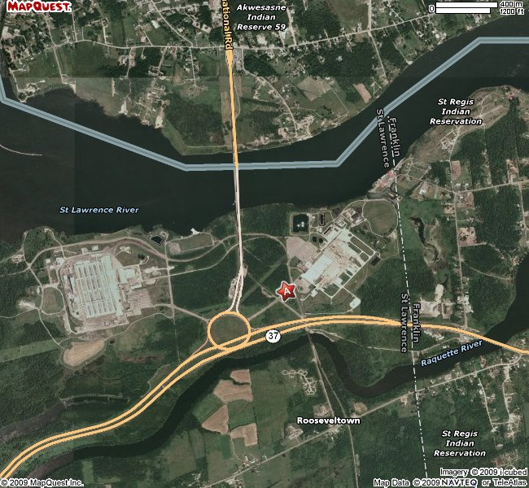
GM Plant Vicinity Aerial Map
GM PLANT
ALCOA PLANT

