Slide 1
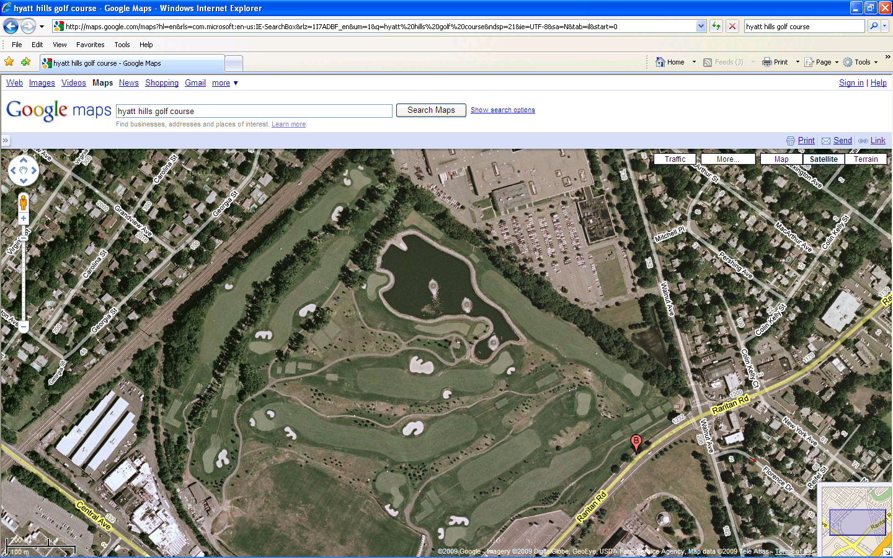
Hyatt Hills Golf Course
[ Location: Clark, NJ
History: NEED TO UPDATE HISTORY
Approximate Size: NEED SIZE
Status: Idled in 2007
WILL TRY TO GET BETTER AERIAL ]

