Slide 1
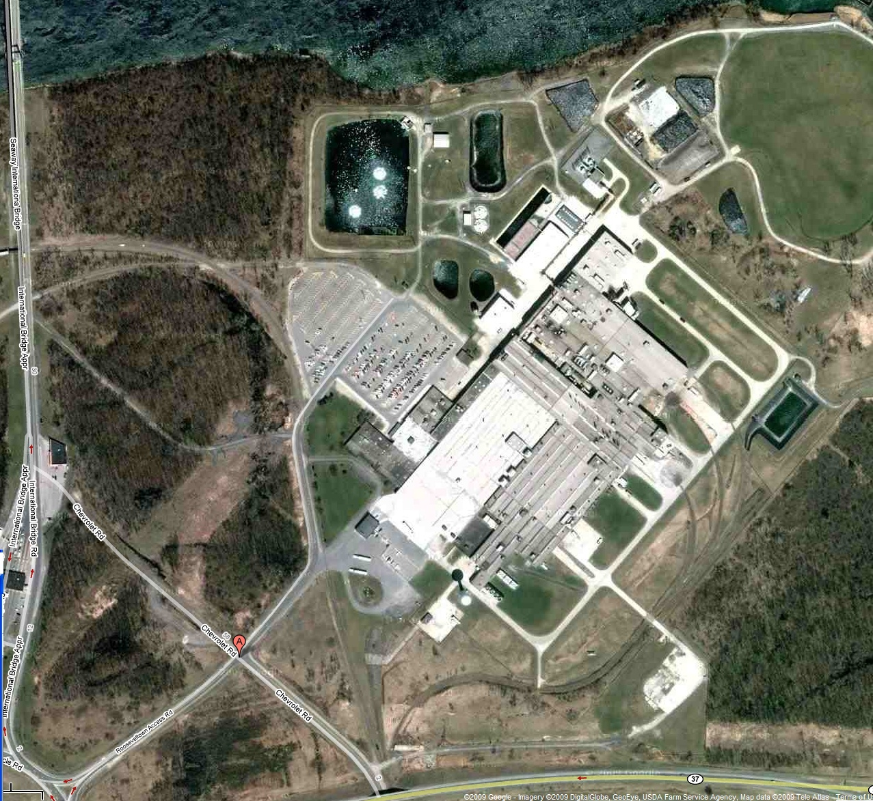
Massena, NY
Location: Massena, NY
Earliest Service Date: 1959
Approximate Size: 1.0MM Sq. ft.
Models Built: 2.2L engine blocks
Status: Idled May 2009

Slide 2
Massena, NY

