Slide 1
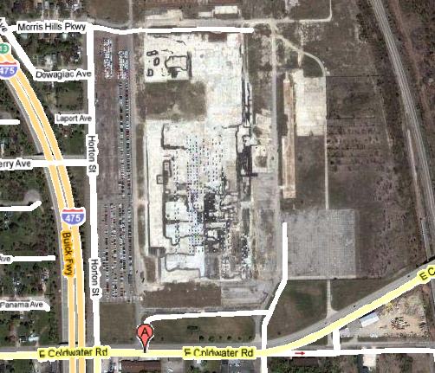
Flint - Coldwater

