Slide 1
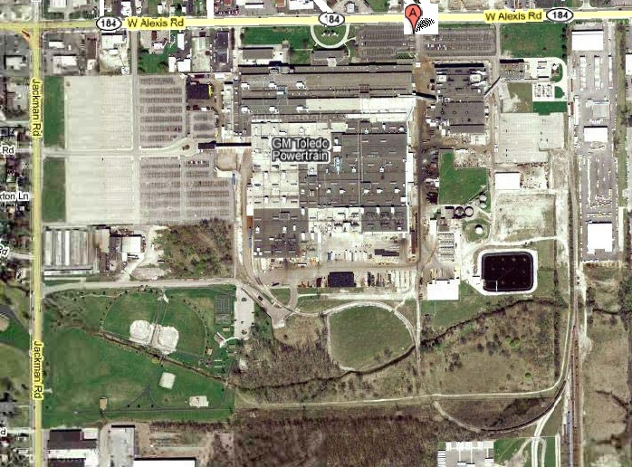
Donate: Toledo REALM Parcel

