Slide 1
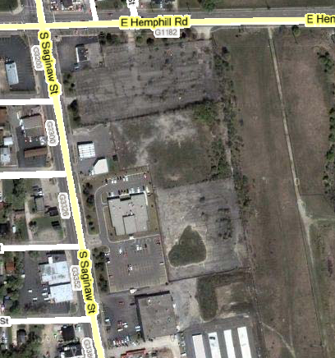
Hemphill Lot (~7 acres)

